Slide 1
Enterprises use a combination
Organize Subscriptions via Management Groups
Microsoft Defender for Cloud – Just in Time Access (JIT)
a. Recommendations
b. Workflow Automation enable JIT on VM automatically
Custom Azure Policies
a. Audit - Compliance
Append – at time of deployment
Deny – prevent deployment
Deploy if Not Exists (DINE) – remediate existing deployments
Network Security Workbook – Policy Compliance – Secure Score

Slide 2
Let look at the older approach and then what is now available: Azure Virtual Network Manager (AVNM)

Slide 3
Enterprises roll out slowly
Start testing Just in Time Access (JIT) in Azure Subscriptions
Start testing Policy on a Resource Groups and then Subscriptions
Recommendations – trigger notifications to Azure Owners – via emails (Workflow automation)
Is Governance Risk and Compliance (GRC) using Secure Score and Control ‘Secure management ports’
Root Management group
Management group
Subscription
Resource group
Resource (NSG)

Slide 4
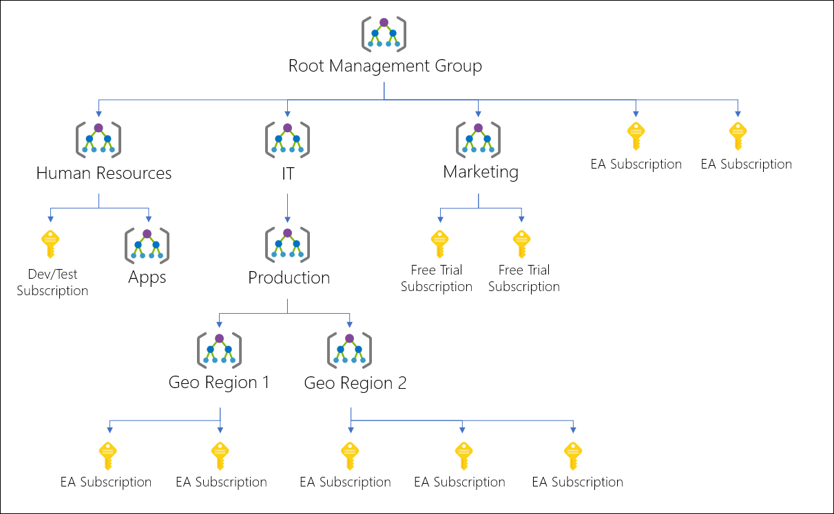
Azure Management Group

Slide 5
Personas – Landing Zones – An Example
landing zone 1 - no vpn to company, no public access
landing zone 2 - sensitive information or VPN back to company, << Need to understand R&D - VMs --> (300 developers) <- Azure Defender for Servers, Azure Defender for PaaS | MDE installed – Windows – Linux.
landing zone 3 - Corp IT, Hosted Customers Environments. VDC, tanium (updates), existing tools, amp (av), Prisma (posture mgmt) \ PaaS Stuff <- Azure Defender for PaaS

Slide 6
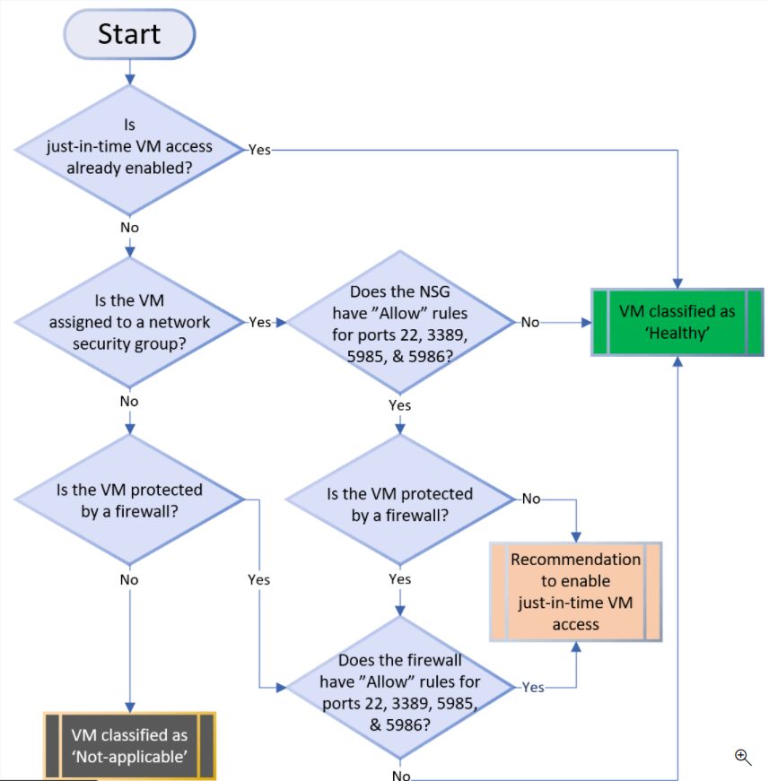
Defender for Cloud – Just in Time Access (JIT)
Microsoft Defender for Servers is turned on in Azure Subscription or MG
Workflow Automation – New VM – receives JIT
Azure Policy to auto deploy Workflow Automation across Subs in MG.
Assigned via REST API

Slide 7
Custom Azure Policy based on needs
Audit (continual operation)
Deny (greenfield)
Append (greenfield)
Deploy if Not Exists (DINE) (brownfield)
Root Management group
Management group
Subscription
Resource group
Resource (NSG)

Slide 8
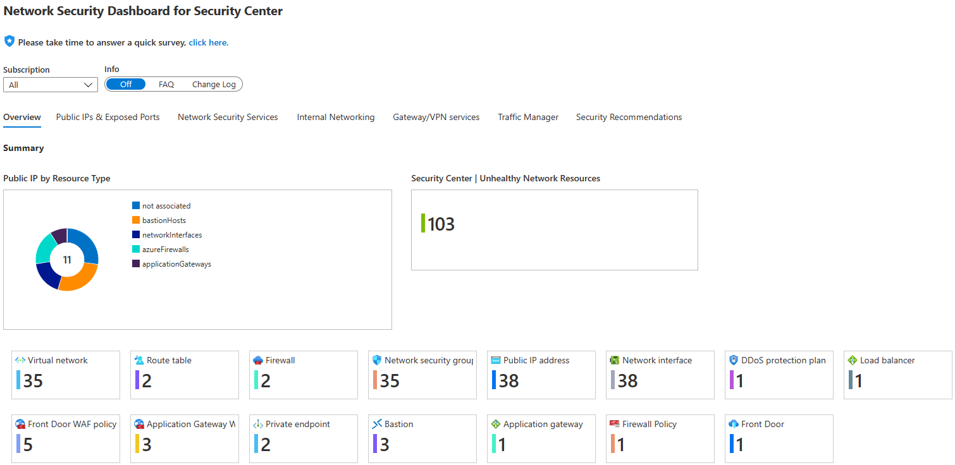
Network Security Dashboard

Slide 9
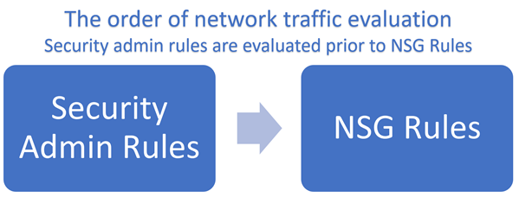
Introducing Azure Virtual Network Manager (AVNM) – Security Admins

Slide 10
(AVNM) resource
Scoped: MG
Sub
RG
Network
Groups
Dynamic membership: tag = ‘sales’, rg contains ‘prod-’
Static membership: select vnets in picker
Security Admin Configurations
Deploy a configuration
Target regions
EnterpriseSecurityBoundary
Target Network Groups
(VNETs)
Rule collection:
Priority,direction,protocol,source,srcport,destination,destport,action
Priority,direction,protocol,source,srcport,destination,destport,action

Slide 11
EnterpriseSecurityBoundary
Rule collection: AllowNexsusScanners
136.57.171.148allow,100,Inbound,any,136.57.171.148,*,allow
Rule collection: BlockInternetInbound
denyInternetRDP,200,Inbound,any,Internet,3389,deny
denyInternetSSH,210,Inbound,any,Internet,22,deny
Rule collection: FBIBlockList
52.55.244.91MXToolBoxblocked,300,Inbound,any, 52.55.244.91,*,deny
18.205.72.90MXToolBoxblocked,310,Inbound,any, 18.205.72.90,*,deny

